Slide 1
OPERATING SYSTEMS
Notes:
.

Slide 2


SEMAPHORES

Slide 3

PROBLEMS WITH SEMAPHORES
Semaphores provide a powerful tool for enforcing mutual exclusion and coordinating processes.
The wait(S) and signal(S) operations are scattered among several processes. Hence, it is difficult to understand their effects.
Usage of semaphores must be correct in all the processes.
One bad (or malicious) process can fail the entire system of cooperating processes.
Incorrect use of semaphores can cause serious problems.

Slide 4
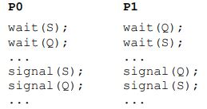
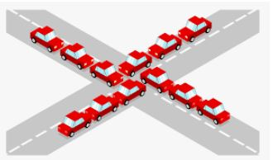
DEADLOCKS
A set of processes are said to be in a deadlock state if every process is waiting for an event that can be caused only by another process in the set
Example of Deadlock
Traffic deadlocks
One-way bridge-crossing
Notes:
Conditions for deadlocks:
Mutual Exclusion: one by one use of resource.
No Preemption
Hold and Wait
Circular Wait

Slide 5
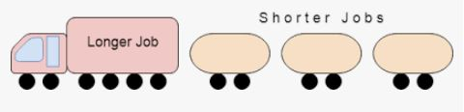
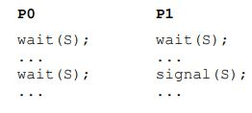
STARVATION
Starvation is infinite blocking caused due to unavailability of resources.

Slide 6
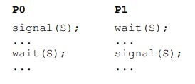
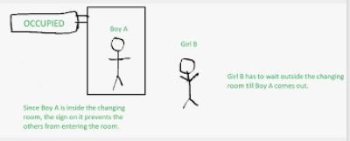
VIOLATION OF MUTUAL EXCLUSION
These problems are due to programming errors because of the tandem use of the wait and signal operations.
The solution to these problems is higher-level language constructs such as critical region (region statement) and monitor.

Slide 7
SEMAPHORE
There are two kinds of semaphores:
Counting semaphore—whose integer value can range over an unrestricted integer domain.
Binary semaphore—whose integer value cannot be > 1; can be simpler to implement.

Slide 8
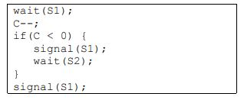
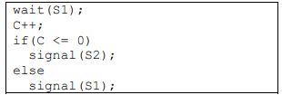
COUNTING SEMAPHORE
Let S be a counting semaphore. To implement it in terms of binary semaphores we need the following data structures:
binary_semaphore S1,S2; // Two binary Semaphores
int C // integer variable set to the initial value of the counting semaphore S
S1=1,S2=0;
wait(S) 🡸signal(S)

Slide 9
COUNTING SEMAPHORE
Mutual Exclusion==No
Progress == Yes
Bounded Waiting== Yes
Note: In the case of counting semaphore the value of C can range from 0 to N, where N is the number of process or thread that has to enter the critical section.

Slide 10
CLASSIC PROBLEMS OF SYNCHRONIZATION
The three classic problems of synchronization are:
Bounded-Buffer Problem
Readers and Writers Problem
Dining Philosophers Problem

Slide 11
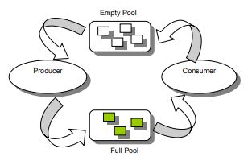
BOUNDED-BUFFER PROBLEM

Slide 12
BOUNDED-BUFFER PROBLEM
Solution:
Shared Data:
Semaphore mutex, full, empty;
mutex=1, full=0, empty =n

Slide 13
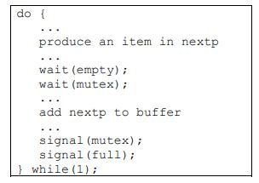
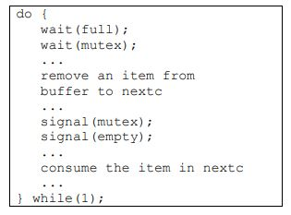
BOUNDED-BUFFER PROBLEM
Producer
Consumer

Slide 14

READERS WRITERS PROBLEM

Slide 15
READERS WRITERS PROBLEM
A data object (such as a file or a record) is to be shared among several concurrent processes.
Some of these processes, called readers, may want only to read the content of the shared object whereas others, called writers, may want to update (that is to read and write) the shared object.
Obviously, if two readers access the data simultaneously, no adverse effects will result.
However, if a writer and some other process (whether a writer or some readers) access the shared object simultaneously, chaos may ensue.
To ensure these difficulties do not arise, we require that the writers have exclusive access to the shared object.
This synchronization problem is referred to the readers writers problem.

Slide 16
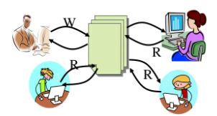
READERS WRITERS PROBLEM
The readers-writers problem has several variations, all involving priorities.
The simplest one, referred to as the first readers-writers problem, requires that no reader will be kept waiting unless a writer has already obtained permission to use the shared object.
In other words, no reader should wait for other readers to finish simply because a writer is waiting.
https://www.slideshare.net/ManthiravalliKrishnan/reader-writer-problem

Slide 17
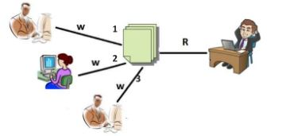
READERS WRITERS PROBLEM
The second readers-writers problem requires that once a writer is ready, that writer performs its write as soon as possible.
In other words, if a writer is waiting to access the object, no new readers may start reading.
https://www.slideshare.net/ManthiravalliKrishnan/reader-writer-problem

Slide 18
READERS WRITERS PROBLEM
A solution to either problem may result in starvation. In the first case, writers may starve; in the second case, readers may starve.

Slide 19
READERS WRITERS PROBLEM
Solution: (first readers writers problem):
semaphore mutex, wrt;
int readcount=0;
mutex= 1 , wrt= 1;

Slide 20
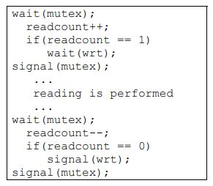
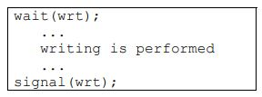
READERS WRITERS PROBLEM
Solution: (first readers-writers problem):
Reader
Writer

Slide 21
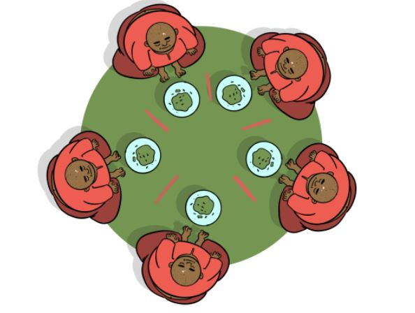
Dining
Philosophers
Problem

Slide 22
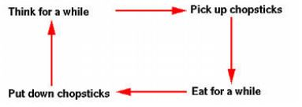
DINING PHILOSOPHERS PROBLEM
Consider five philosophers who spend their lives thinking and eating, as shown in the diagram.

Slide 23
DINING PHILOSOPHERS PROBLEM
The philosophers share a common circular table surrounded by five chairs, each belonging to one philosopher.
In the center of the table is a bowl of rice, and the table is laid with five single chopsticks.
When a philosopher thinks, she does not interact with her colleagues.
From time to time, a philosopher gets hungry and tries to pick up the two chopsticks that are closest to her (the chopsticks that are between her and her left and right neighbors).
A philosopher may pick up only one chopstick at a time.
Obviously, she cannot pick up a chopstick that is already in the hand of her neighbor.
When a hungry philosopher has both her chopsticks at the same time, she eats without releasing her chopsticks.
When she is finished eating, she puts down both of her chopsticks and starts thinking again.

Slide 24
DINING PHILOSOPHERS PROBLEM
The dining philosophers problem is considered to be a classic synchronization problem because it is an example of a large class of concurrency control problems.
It is a simple representation of the need to allocate several resources among several processes in a deadlock and starvation-free manner.
Notes:
.

Slide 25
DINING PHILOSOPHERS PROBLEM
Solution:
semaphore chopstick[5];
All initialized to 1;
A philosopher tries to grab the chopstick by executing a wait operation on that semaphore;
she releases her chopsticks by executing the signal operation on the appropriate semaphores.

Slide 26
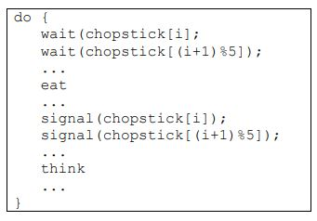
DINING PHILOSOPHERS PROBLEM
The structure of philosopher i is as follows:

Slide 27
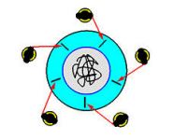
DINING PHILOSOPHERS PROBLEM
Although this solution guarantees that no two neighbors are eating simultaneously,
It nevertheless must be rejected because it has the possibility of creating a deadlock.
Suppose that all five get hungry at the same time and pick up their left chopsticks as shown in the following figure.
In this case, all chopsticks are locked and none of the philosophers can successfully lock her right chopstick.
As a result, we have a circular waiting (i.e., every philosopher waits for his right chopstick that is currently being locked by his right neighbor), and hence a deadlock occurs.

Slide 28
DINING PHILOSOPHERS' PROBLEM
Several possibilities that remedy the deadlock situation.
Each results in a good solution for the problem.
Allow at most four philosophers to be sitting simultaneously at the table.
Allow a philosopher to pick up her chopsticks only if both chopsticks are available (to do this she must pick them up in a critical section)
Use an asymmetric solution; that is, an odd philosopher picks up first her left chopstick, whereas an even philosopher picks up her right chopstick and then her left chopstick.

Slide 29
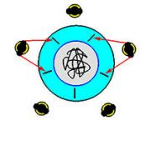
DINING PHILOSOPHERS PROBLEM
Removing the possibility of deadlock does not ensure that starvation does not occur.
Imagine that two philosophers are fast thinkers and fast eaters.
They think fast and get hungry fast.
Then, they sit down in opposite chairs as shown below.
Because they are so fast, it is possible that they can lock their chopsticks and eat.
After finish eating and before their neighbors can lock the chopsticks and eat, they come back again and lock the chopsticks and eat.
In this case, the other three philosophers, even though they have been sitting for a long time, they have no chance to eat.
This is starvation.
Note that it is not a deadlock because there is no circular waiting, and everyone has a chance to eat!

